Slide 1
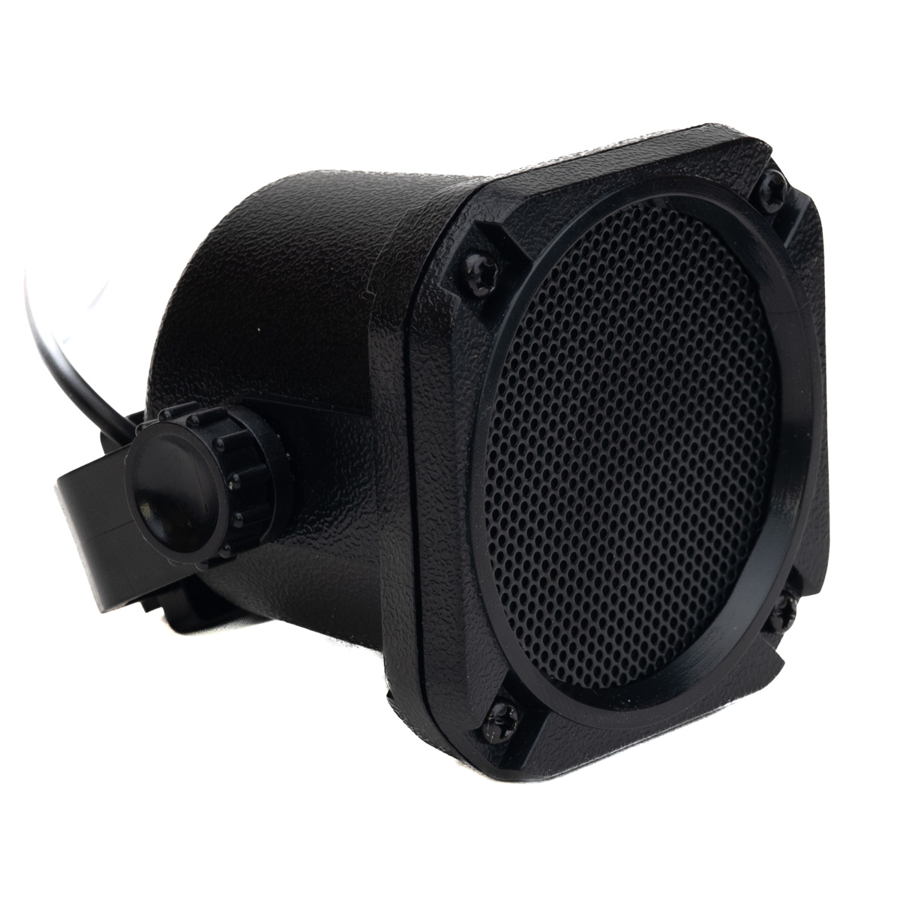
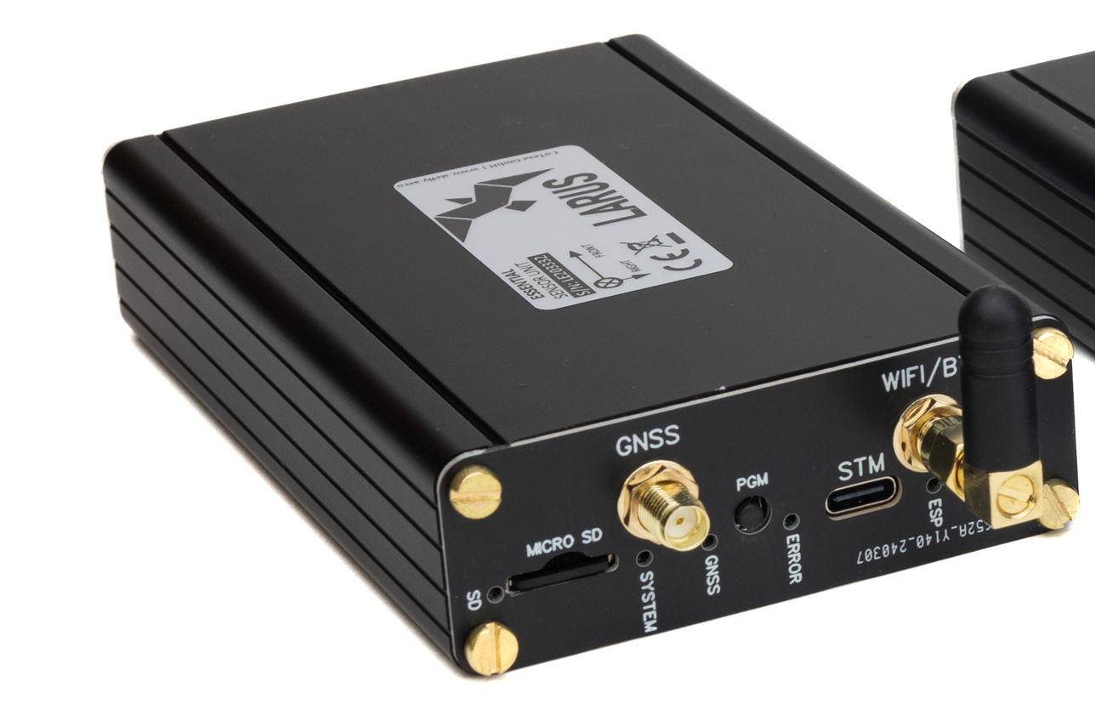
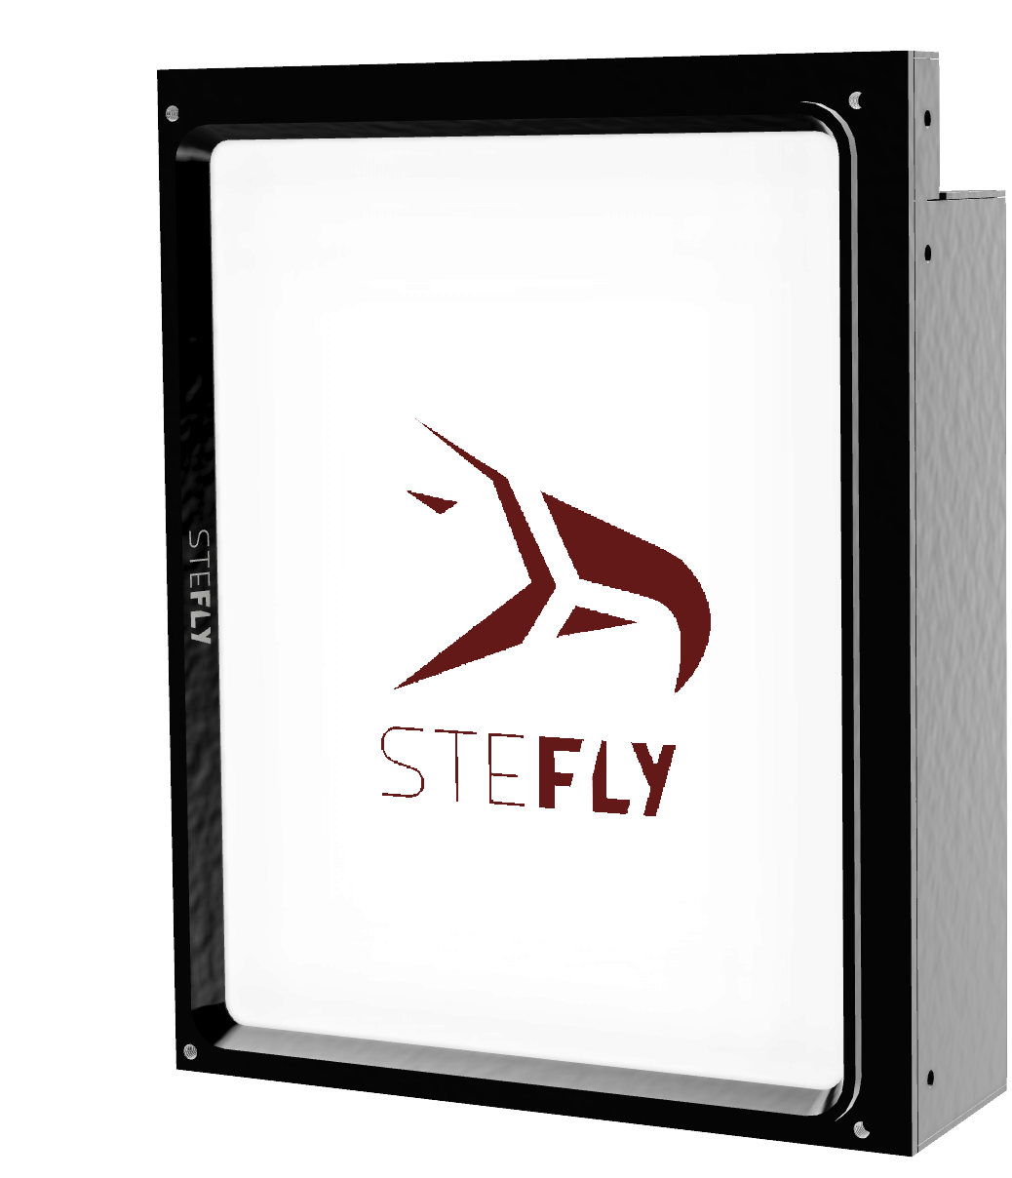
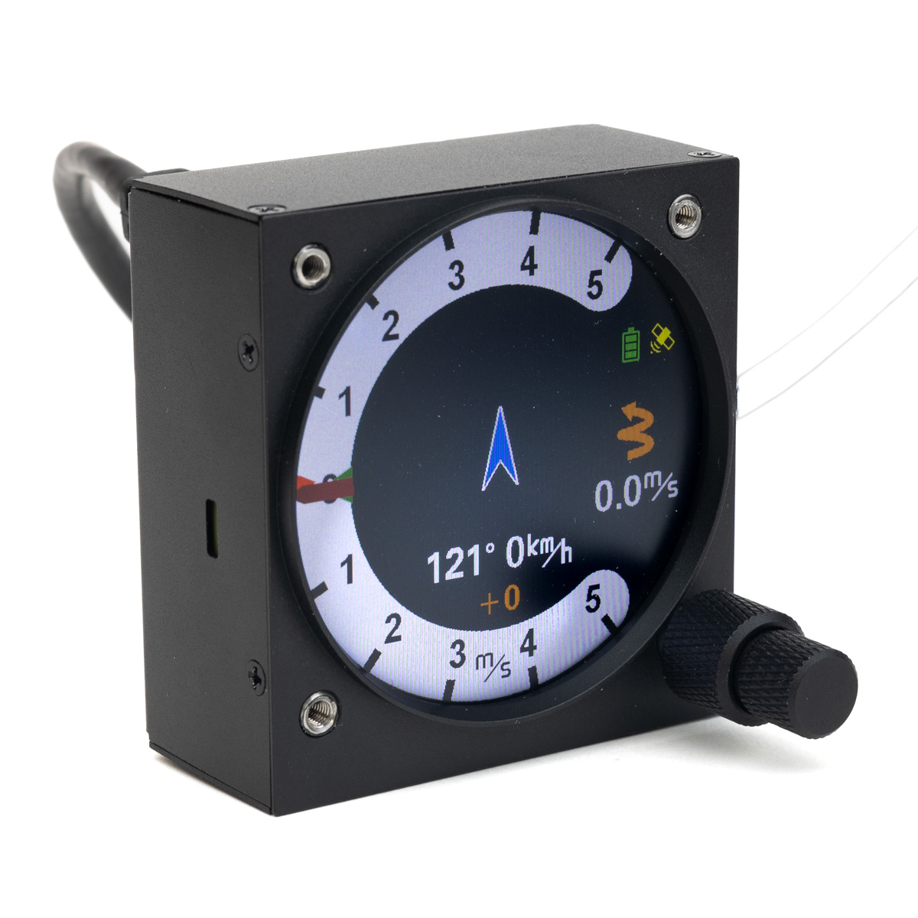
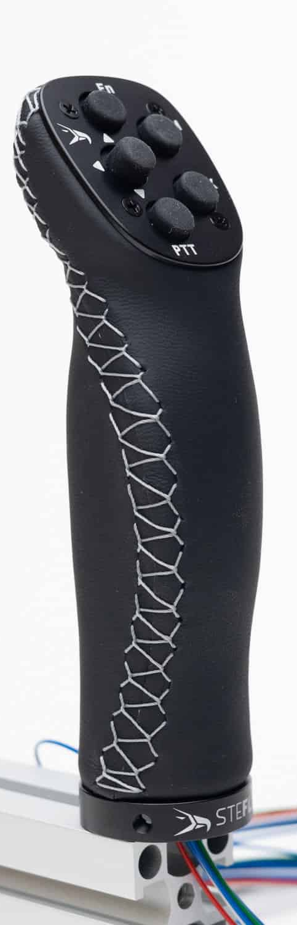
3,5 mm audio jack
1:1 patch cable
Option 2: 1:1 patch cable
CAN port
CAN port
RS232 port
ttySx
RS232 port
Option 1: Rx / Tx crossed patch cable
ttySz
STF / Vario
Switch connected to Remote Control PCB
USB cable

Slide 2
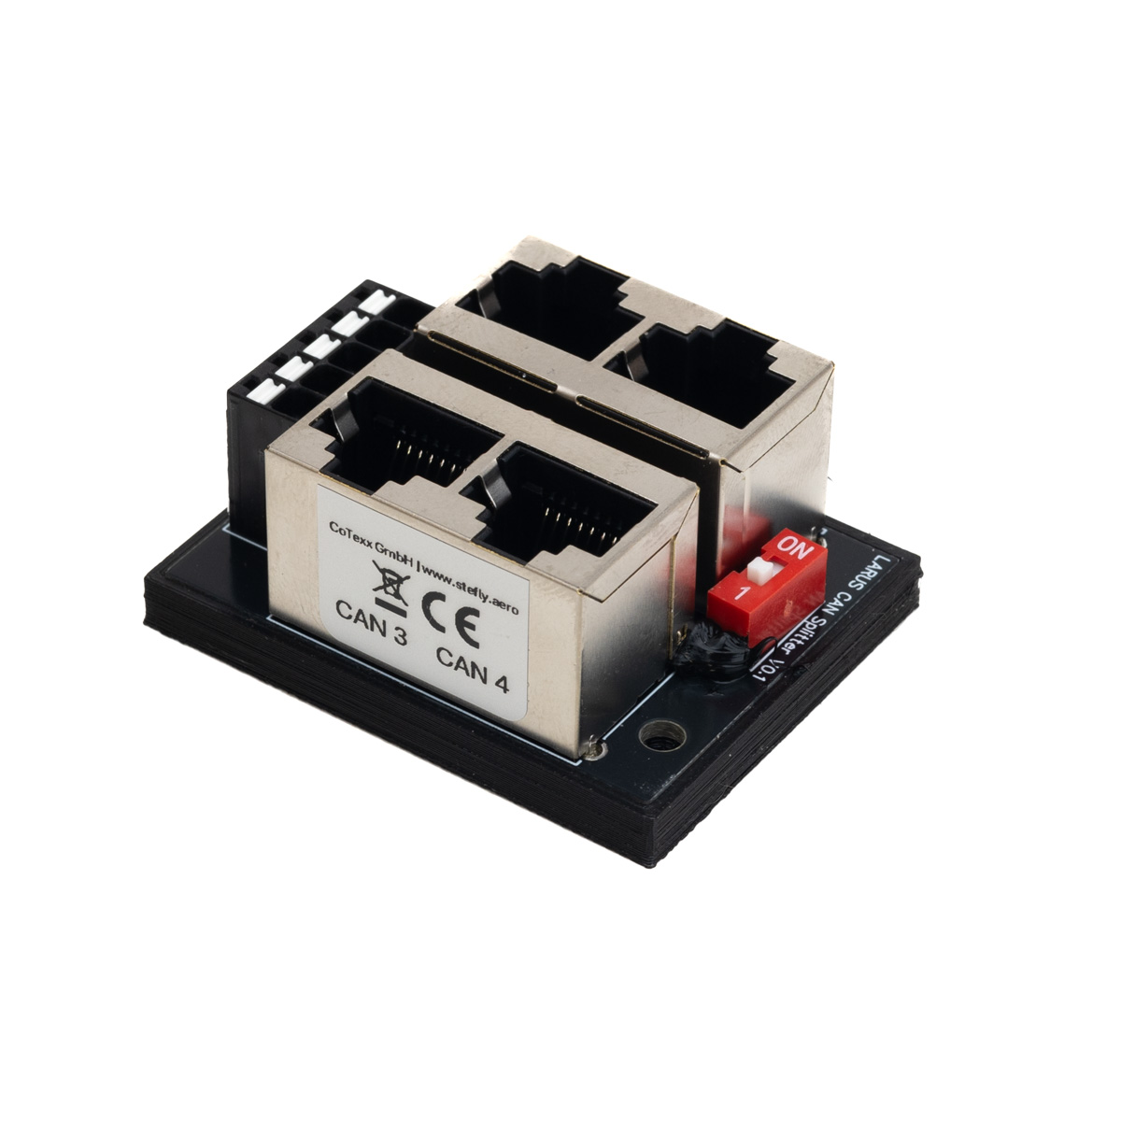
3,5 mm audio jack
1:1 patch cable
1:1 patch cable
CAN port
CAN port
CAN port
CAN port
RS232 port
CAN port
RS232 port
patch cable with RX / TX crossed
Option 1:
patch cable with RX / TX crossed
ttySx
CAN port
ttySx
Option 2:
patch cable with 1:1 patch cable
ttySx
RS232

Slide 3
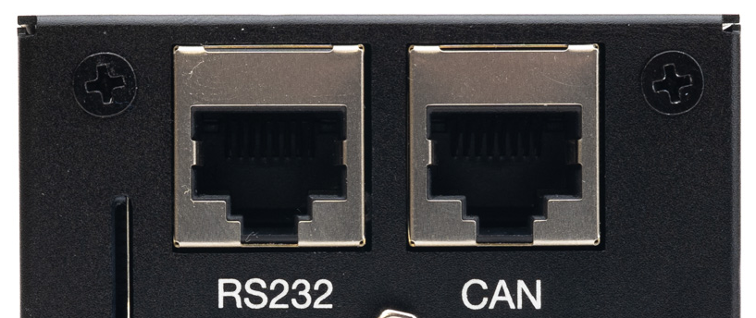
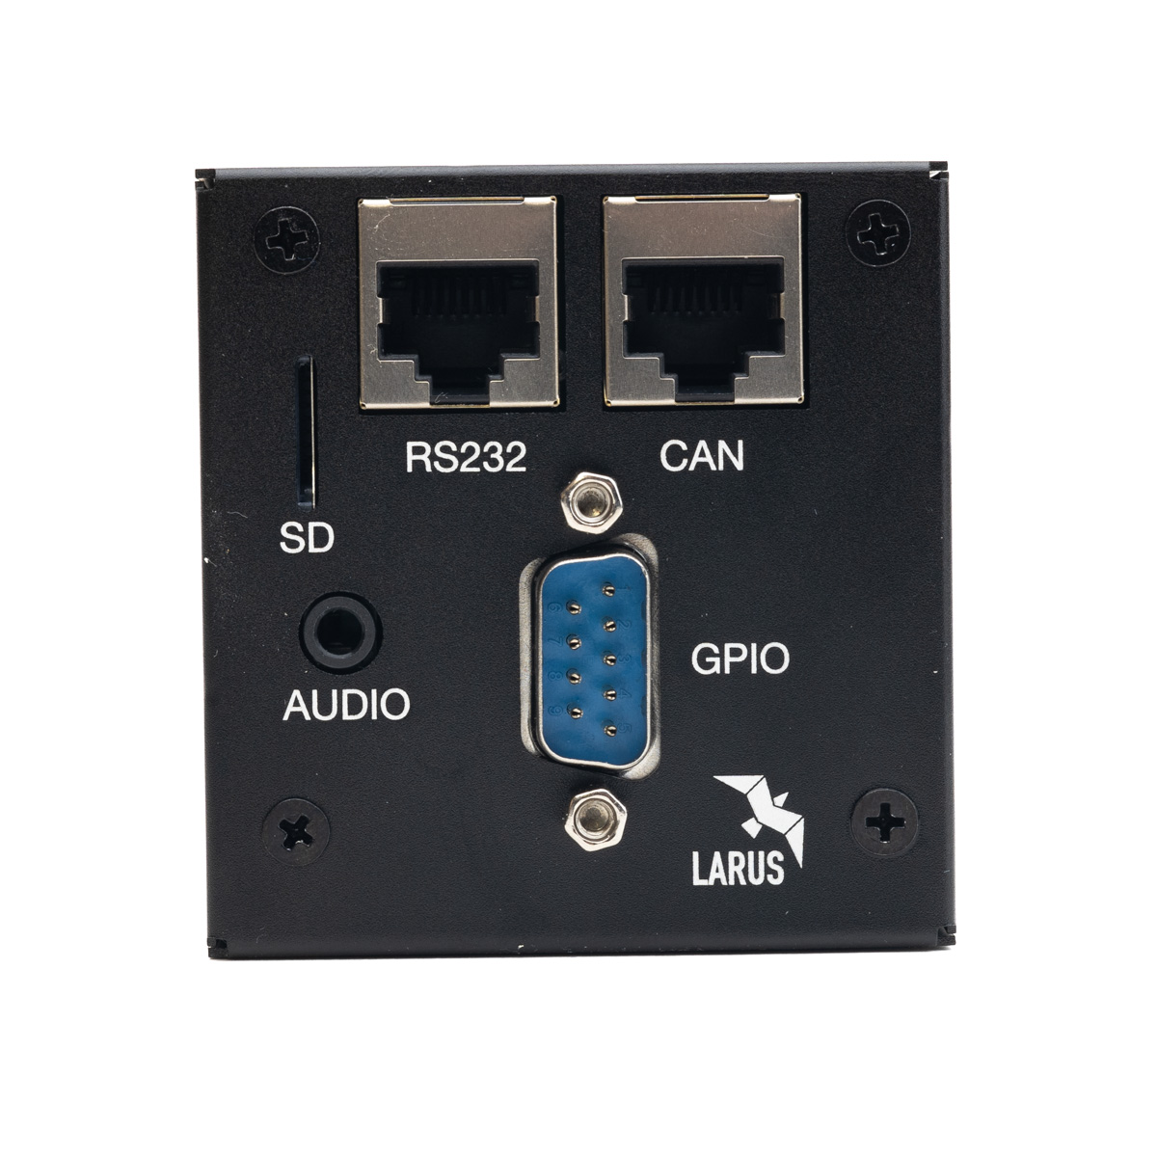
1 2 3 4 5 6 7 8
1 2 3 4 5 6 7 8

Slide 4
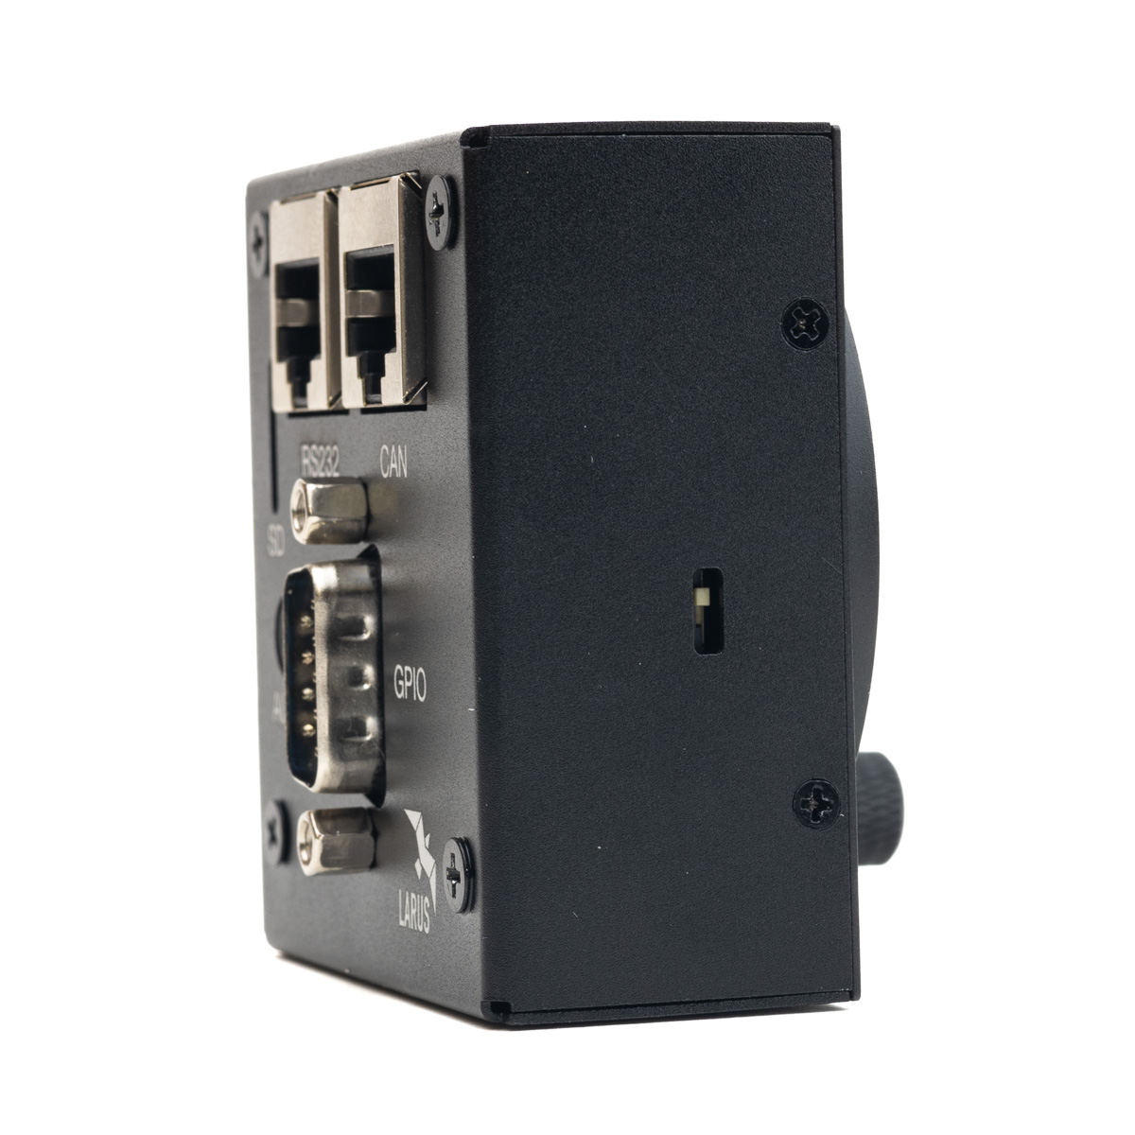
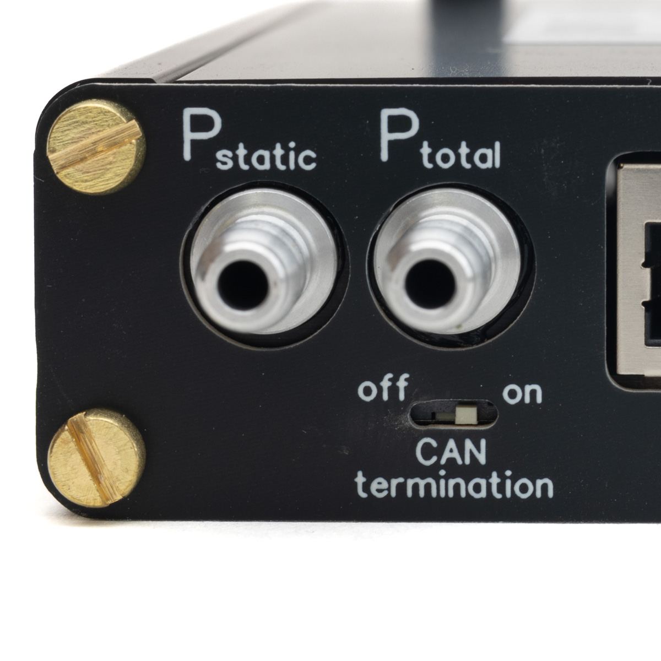
on
on
off
off
off
on
CAN termination switch
LARUS Vario Display
CAN termination switch
LARUS Sensor Box
CAN termination switch
CAN Splitter

Slide 5
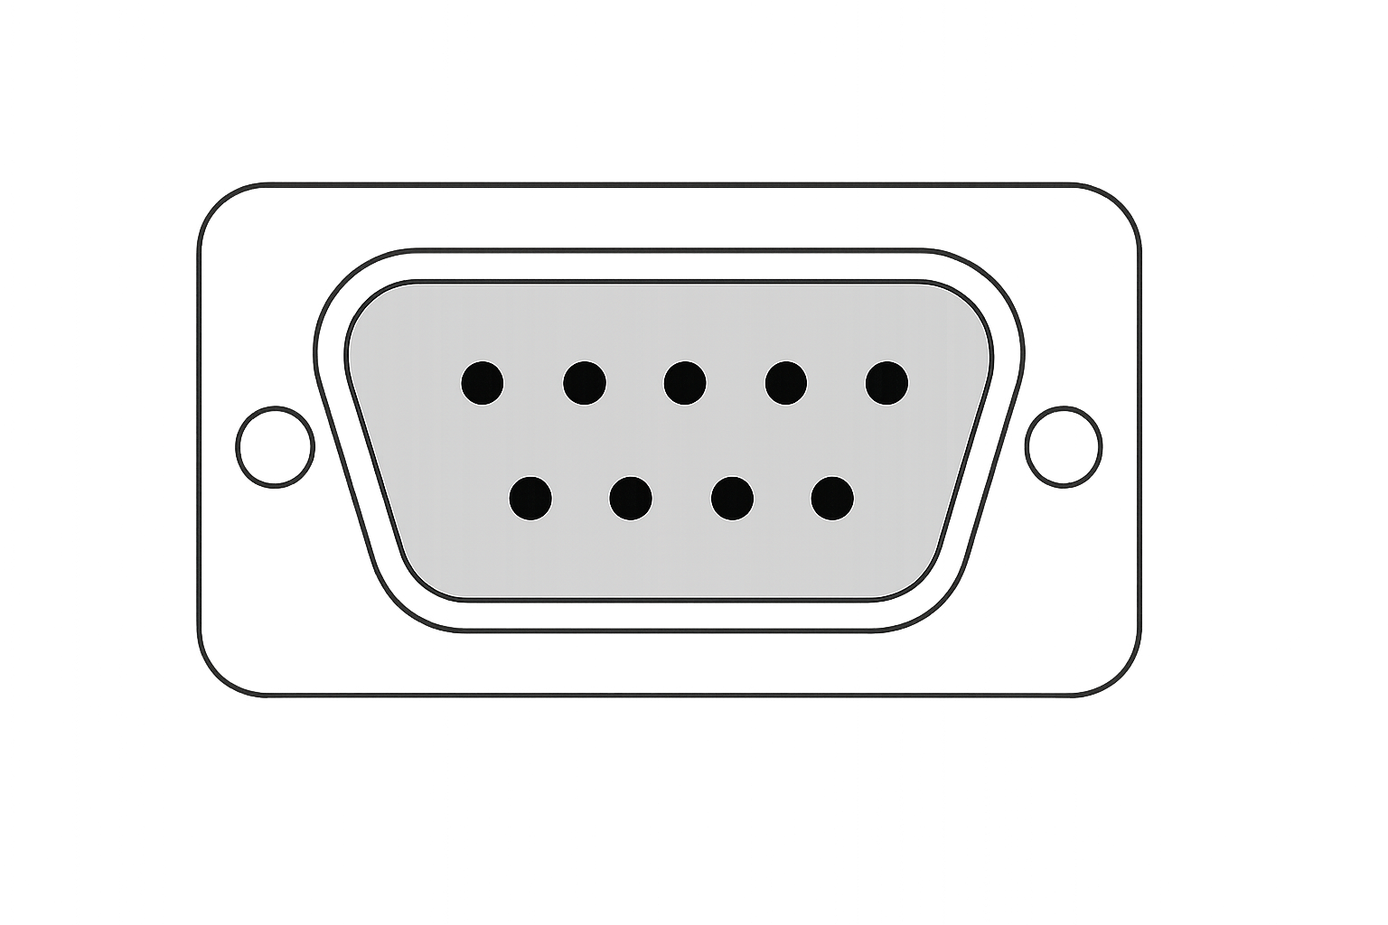
View from the back into male connector of Vario Display.
For pin identification these numbers are also molded into the female connector (scope of delivery)
1
5
6
9
Pin Number | Pin Name | I/O
1 | GND | — (Ground)
2 | DI3 – Gear | Input
3 | DI1 – Waterballast | Input
4 | DO2 | Output
5 | GND | — (Ground)
6 | DI4 – Speed Brakes | Input
7 | DI2 – Speed to Fly | Input
8 | GND | — (Ground)
9 | DO1 – SteFly Canopy Flasher | Output

